Slide 1
Switching project 2016-2017 Binary trie – Binary search on prefix lengths comparison
Broggi, Ganassa, Golin, Uboldi
Politecnico di Milano
Telecommunication engineering

Slide 2
Introduction
Goal: to simulate a network under the SDN paradigm.
The project is divided in two main branches: the packet classification and the IP address lookup.
Some useful tools have been used:
Mininet: used to create the network (the topology);
Ryu controller: used to program the controller.
The centre of our project is to compare the performance in different topologies of two algorithms for IP address lookup: binary trie and binary search on prefix lengths.

Slide 3
Theory tips: binary trie
Multi-way trie with each node containing next-hop info and 0/1/2 pointers to child node/s
Each prefix is indetified by a label Pn (n = 1, 2, 3, …)
Construction of the trie
A convention is decided for the whole trie: e.g. zero corresponds to a left arc and one to a right one.
At the end of each arc there is a new node: white, when it doesn’t corresponds to a prefix entry in the database, gray otherwise.
The procedure is iterated. When there is no entry corresponding to a certain bit sequence, no arc (node) is created.

Slide 4
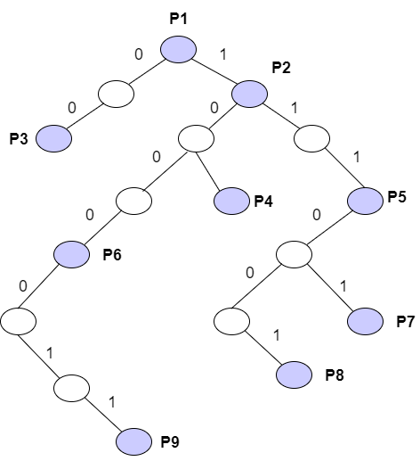
Theory tips: binary trie
Performance
Lookup complexity: O(W)
Storage complexity: O(NW)
Update complexity: O(W)
Where
N: number of prefixes
W: maximum length of the prefix (in bit).
1
Prefix
P1 = *
P2 = 1*
P3 = 00*
P4 = 101*
P5 = 111*
P6 = 1000*
P7 = 11101*
P8 = 111001*
P9 = 1000011*

Slide 5
Theory tips: binary search on prefix length
Key idea: longest prefix matching realized with a series of exact matching operations, each performed on prefixes with the same length
Prefixes of the forwarding table are stored by length in W sub-tables, with W equal to the longest mask of the network.
Binary search is used:
The mask of the destination address is compared with the prefix of length equal to W/2.
If a match is found, it’s sufficient to search only in the upper half of the table iterating the process
Otherwise the iteration is performed on the lower half of the table.

Slide 6
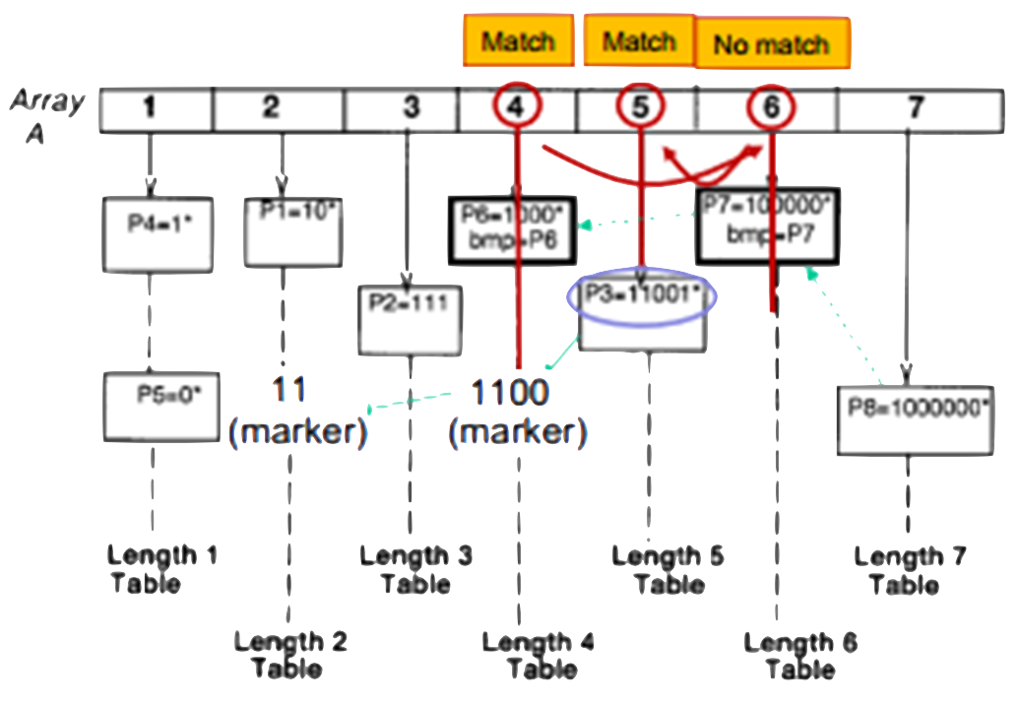
Theory tips: binary search on prefix length
Markers: additional entries in the tables that guarantee correctness
Dest: 11001
Prefix
P1 = 10
P2 = 111
P3 = 11001
P4 = 1
P5 = 0
P6 = 1000*
P7 = 100000*
P8 = 1000000

Slide 7
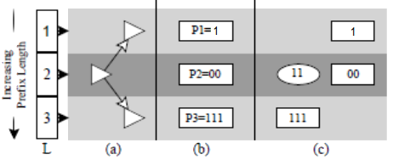
Theory tips: binary search on prefix length
Error in the algorithm
Sometimes the presence of markers can lead along wrong path
Example: destination ‘110’
Binary search
Tables
Markers
11

Slide 8
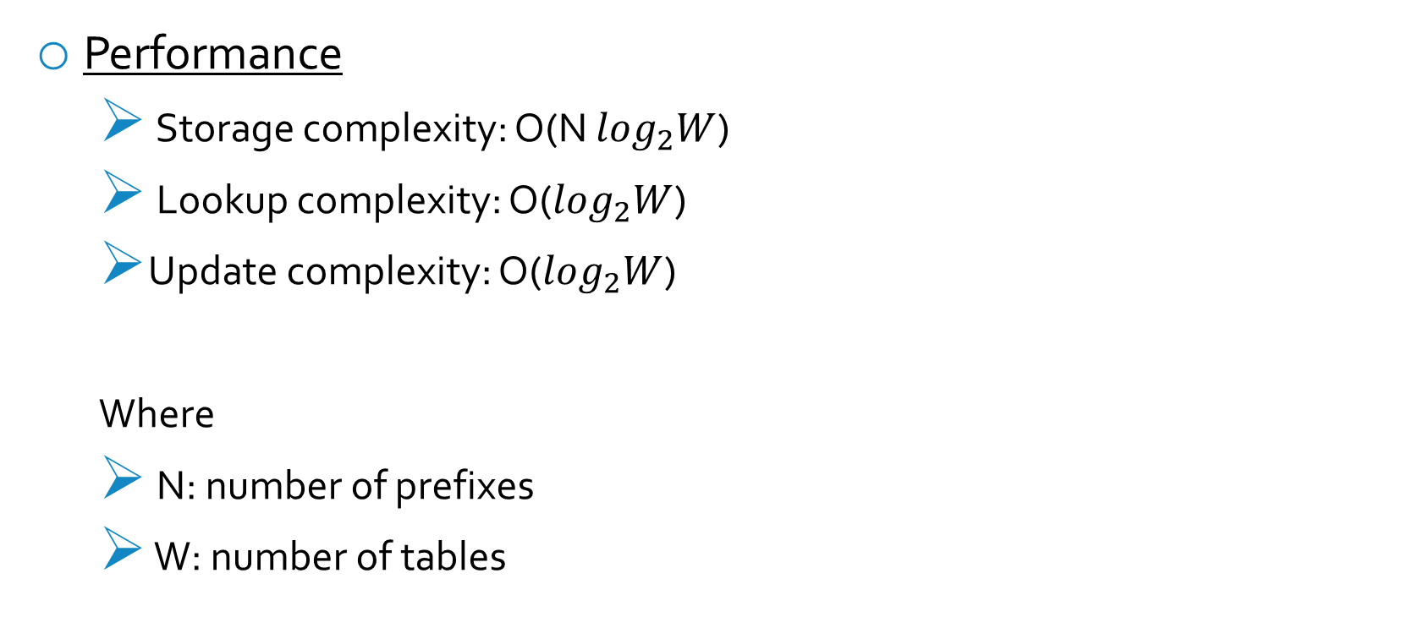
Theory tips: binary search on prefix length
Performance
Storage complexity: O(N $\log_{2}W$)
Lookup complexity: O($\log_{2}W$)
Update complexity: O($\log_{2}W$)
Where
N: number of prefixes
W: number of tables

Slide 9
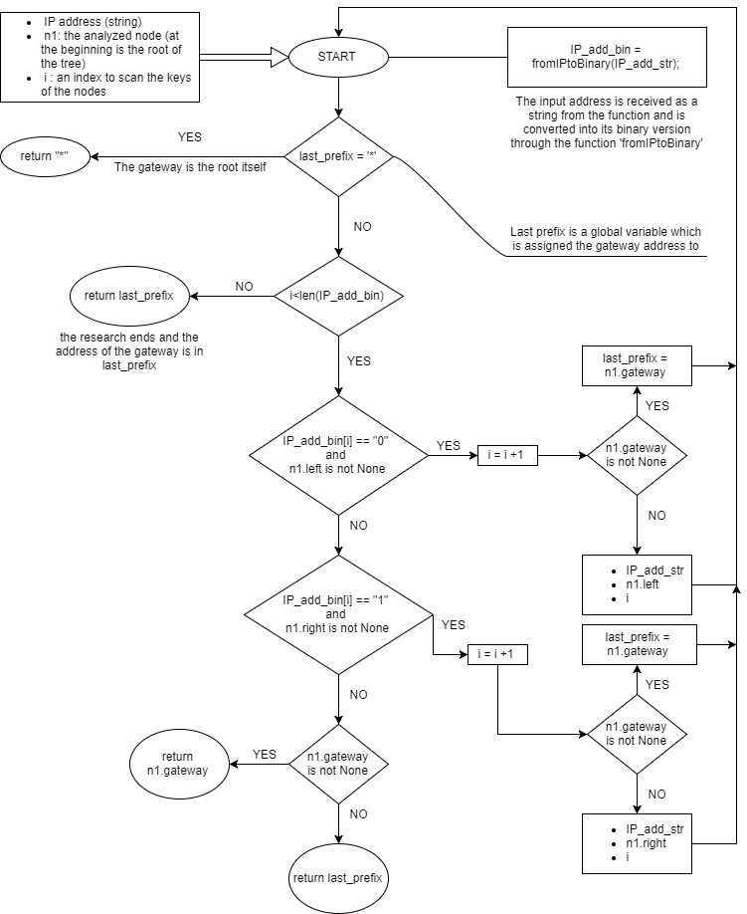
Flow chart: binary trie

Slide 10
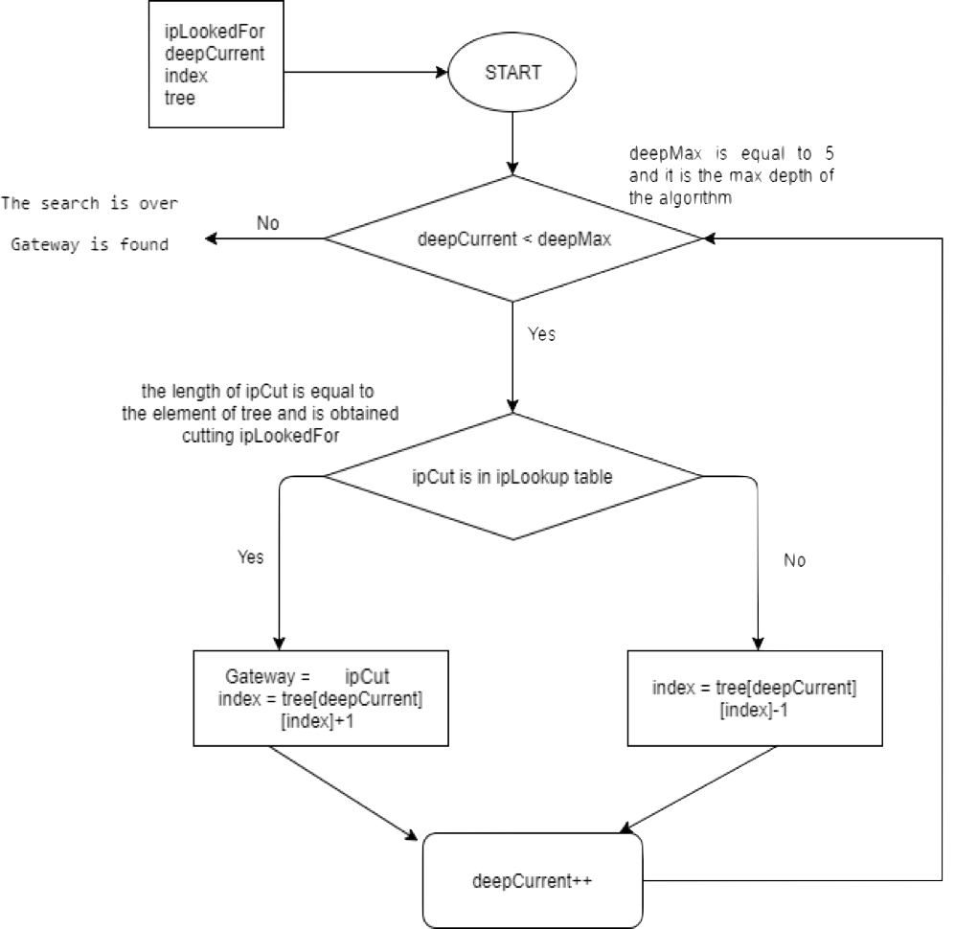
Flow chart: binary search on prefix length

Slide 11
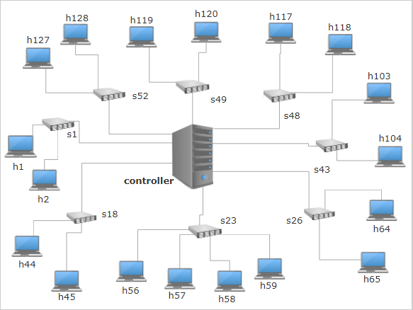
Topologies: small, medium and large
We have adopted three topologies to evaluate the performances related to different netmasks.
The smallest one is composed by 8 switches and 18 hosts.

Slide 12
Topologies: small, medium and large
The medium topology is composed by 20 switches and 48 hosts connected as below:
Switch | Hosts | Switch | Hosts
S1 | h1, h2 | S40 | h96, h97, h98
S7 | h15, h16 | S43 | h103, h104
S14 | h33, h34 | S45 | h108, h109
S18 | h44, h45 | S49 | h119, h120
S22 | h53, h54, h55 | S52 | h127,h128
S23 | h56, h57, h58, h59 | S53 | h129, h130
S26 | h64, h65 | S54 | h131, h132, h133
S31 | h77, h78 | S55 | h134, h135, h136
S35 | h85, h86 | S56 | h137, h138, h139
S38 | h92, h93 | S57 | h140, h141, h142

Slide 13
Topologies: small, medium and large
The largest one is composed by 35 switches and 85 hosts connected in this way:
Switch | Hosts | Switch | Hosts | Switch | Hosts | Switch | Hosts | Switch | Hosts
S1 | h1, h2 | S9 | h19, h20 | S16 | h37, h38, h39 | S35 | h85, h86 | S53 | h129-30
S2 | h3, h4 | S10 | h21, h22, h23 | S17 | h40-1-2-3 | S38 | h92, h93 | S54 | h131-2-3
S3 | h5, h6,h7 | S11 | h24, h25, h26 | S18 | h44, h45 | S40 | h96-7-8 | S55 | h134-5-6
S4 | h8, h9 | S12 | h27, h28 | S22 | h53, h54, h55 | S43 | h103-4 | S56 | h138-9, h140
S5 | h10, h11 | S13 | h29, h30-1-2 | S23 | h56-7-8-9 | S45 | h108-9 | S57 | h140-1-2
S7 | h15, h16 | S14 | h33, h34 | S26 | h64, h65 | S49 | h119-20 | S58 | h143-4
S8 | h17, h18 | S15 | h35. h36 | S31 | h77, h78 | S52 | h127-8 | S59 | h145-6-7

Slide 14
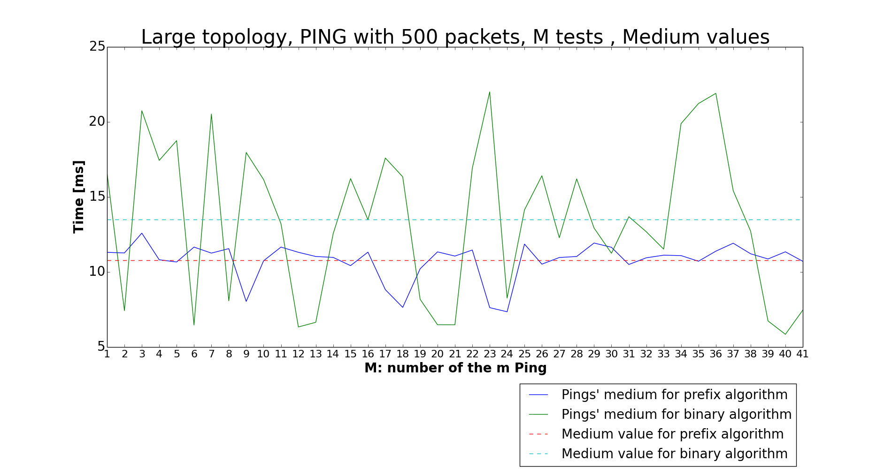
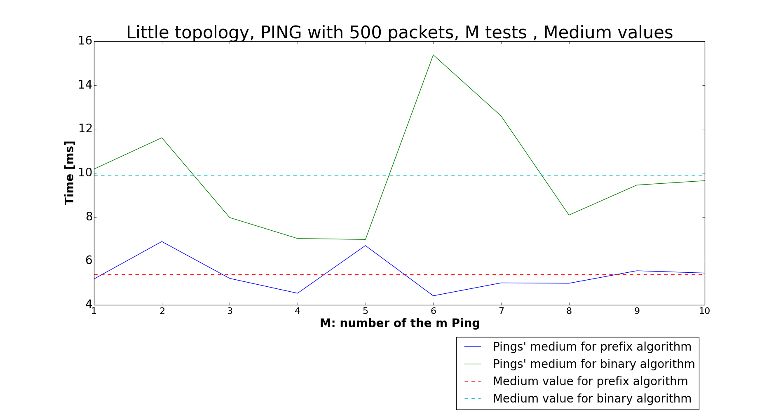
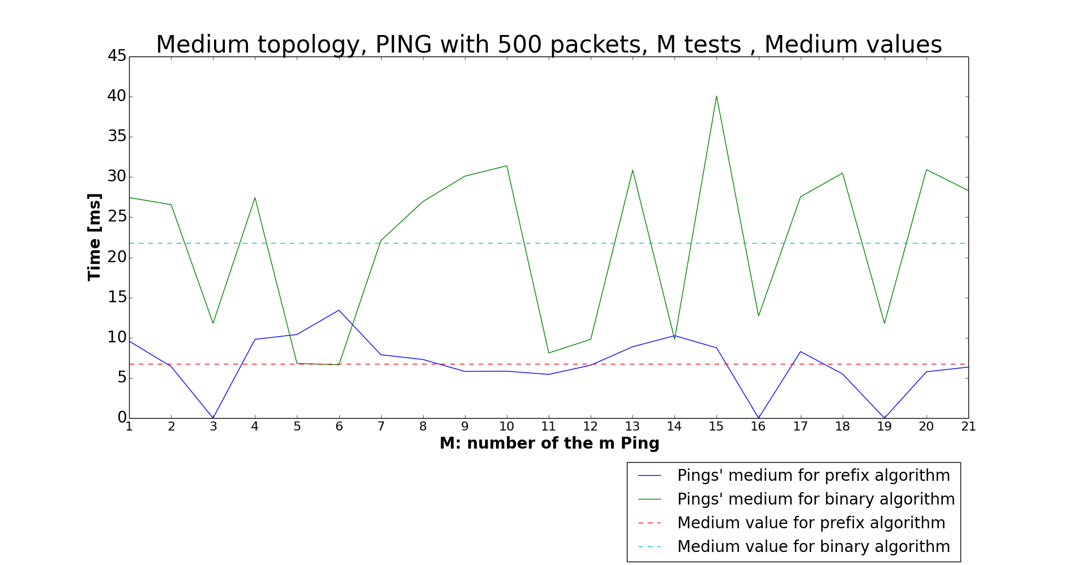
Pings performance analysis
Average values of RTT for the three topologies:
Here are reported our results testing the network.
For every ping between hosts simulated we analyzed four values of the RTT (Round Trip Time): the minimum, the maximum, the average and the rms.
Errors of the algorithm

Slide 15
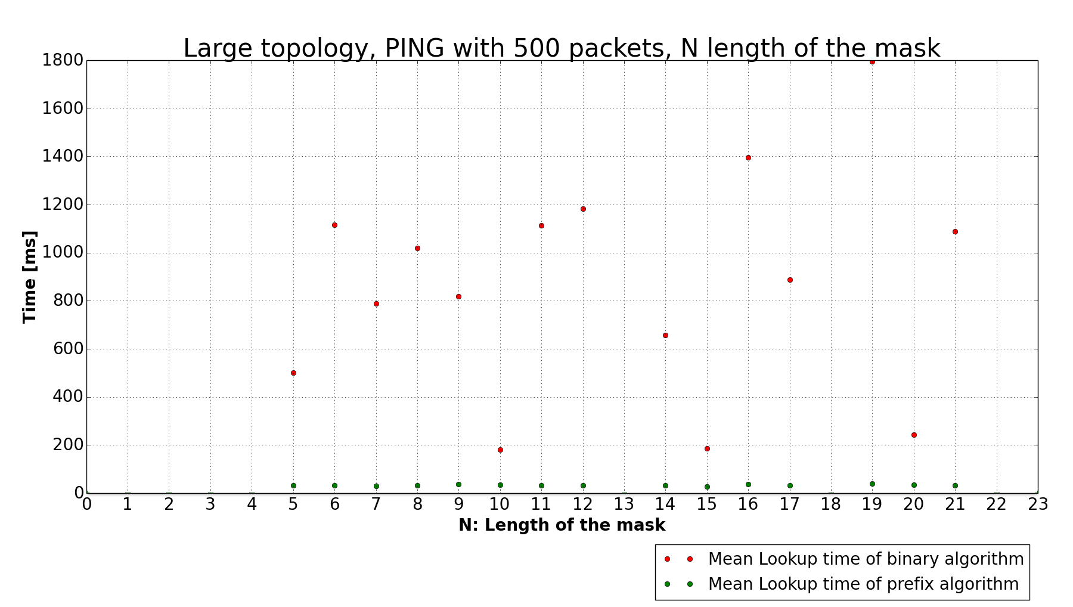
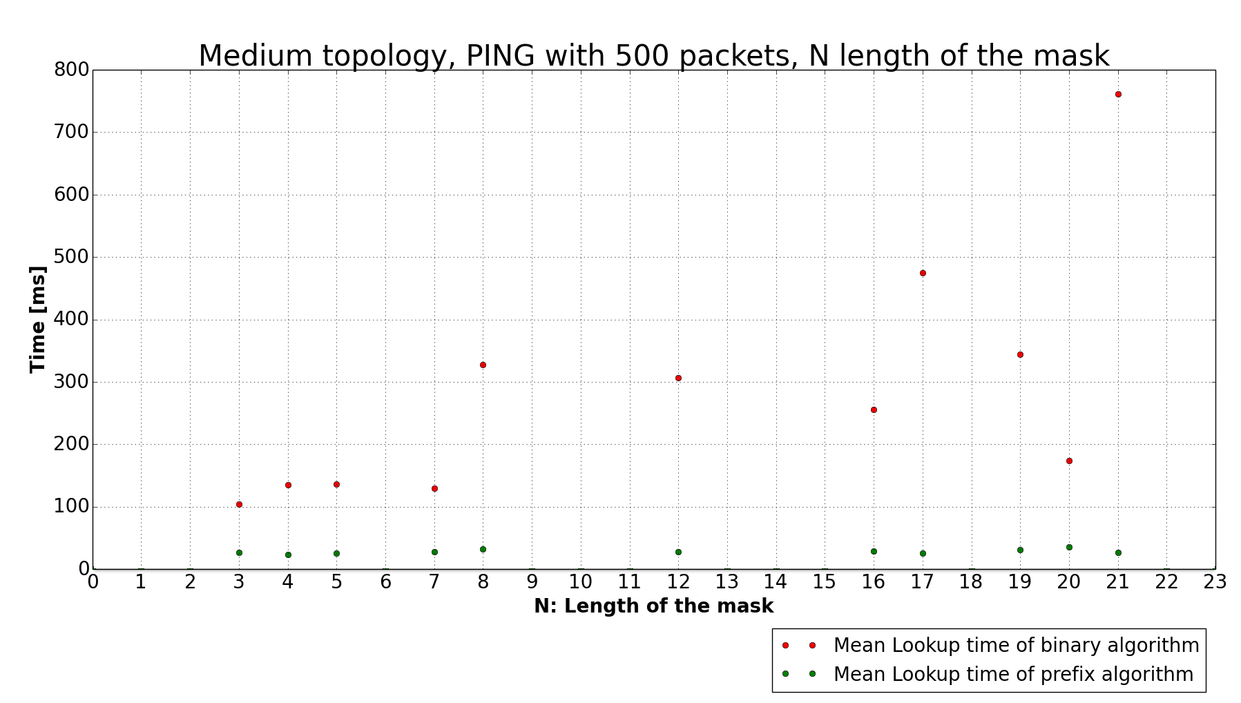
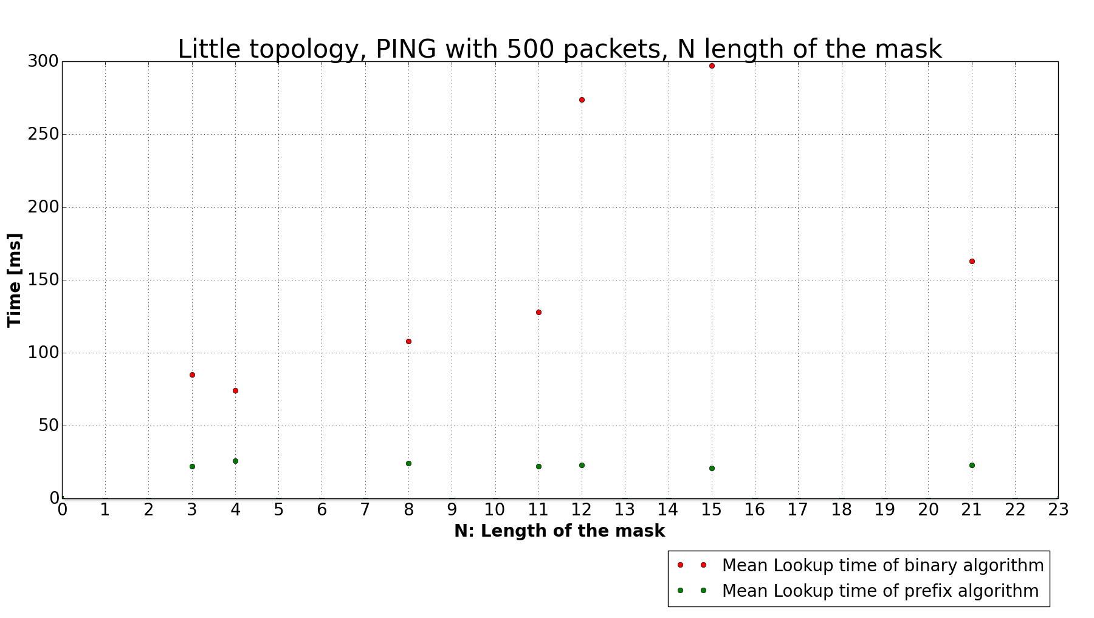
Lookup time performance analysis
The main performance that we need to evaluate is the lookup time of each algorithm for the three topologies.
The lookup time is the time an algorithm needs to find the right destination for a packet of a connection using the lookup tables.

